Slide 1
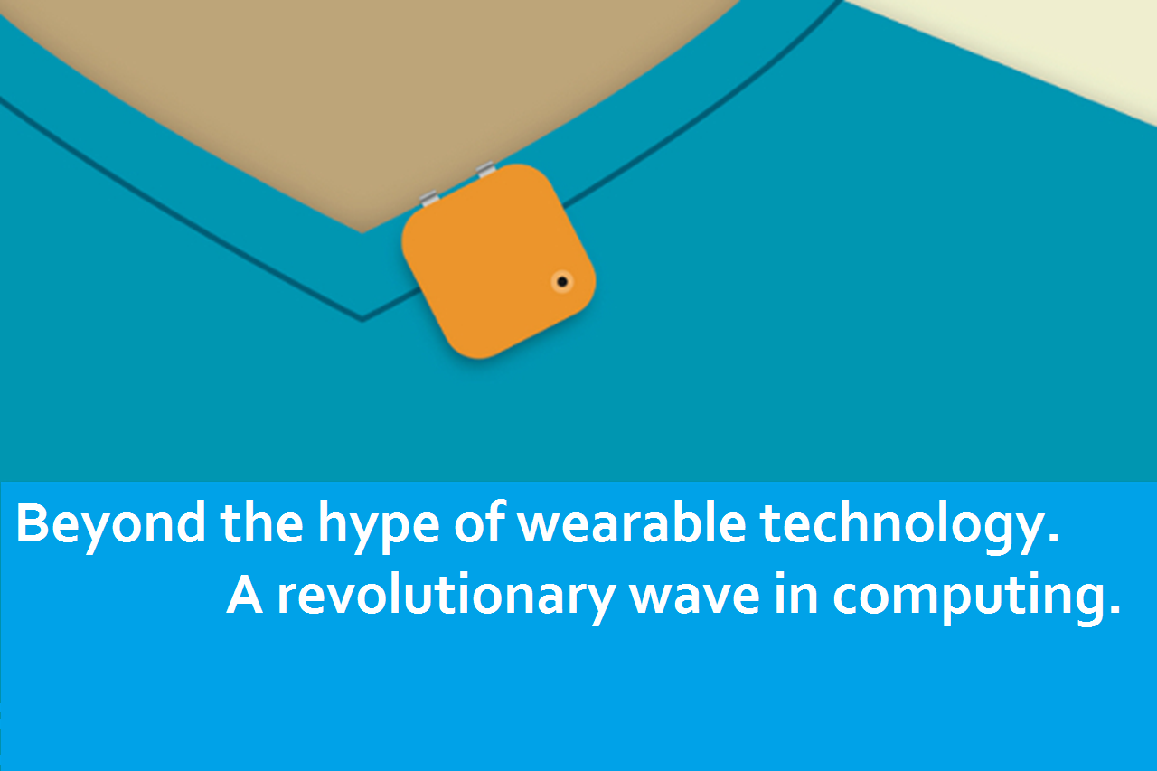

Slide 2
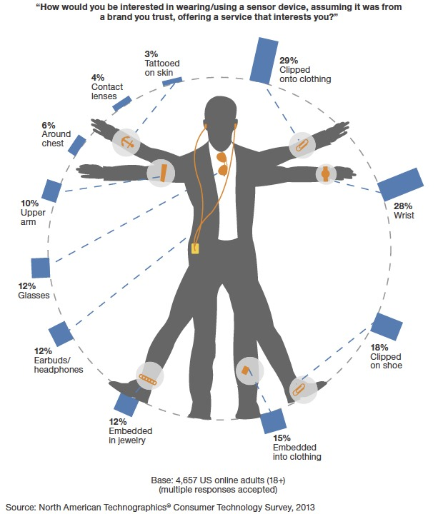
What are wearables ?

Slide 3
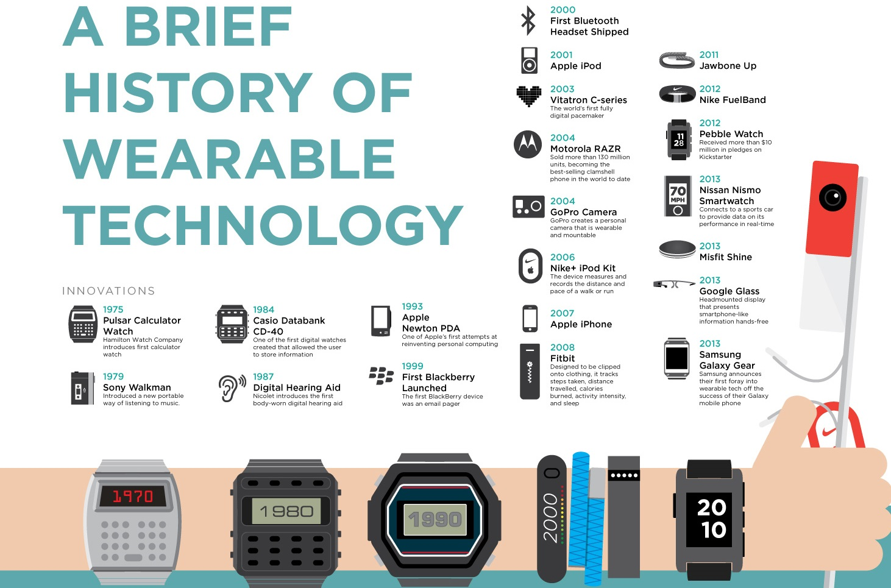

Slide 4
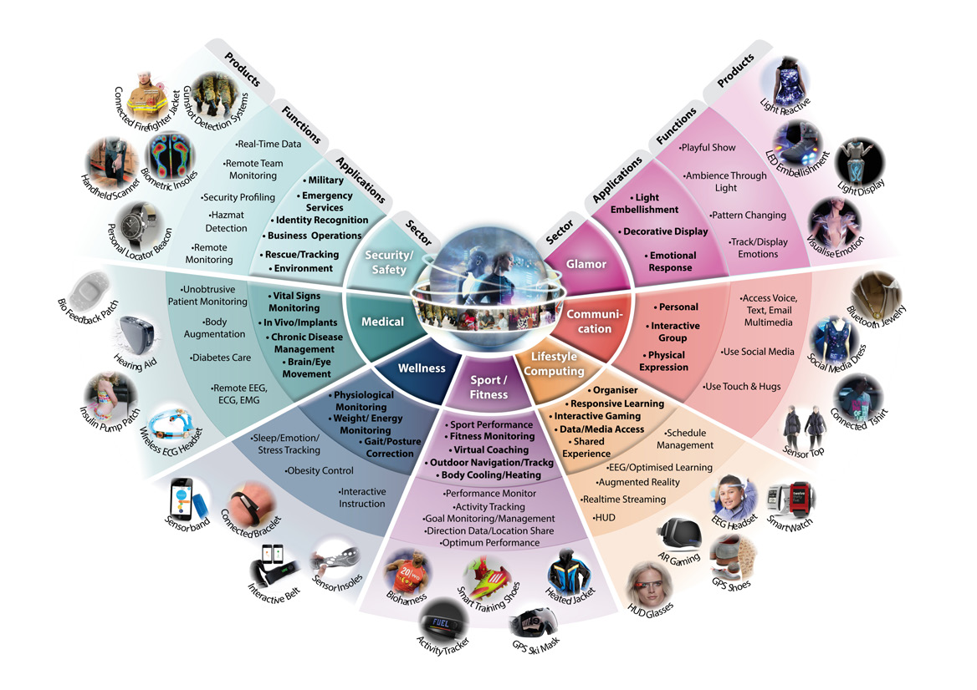
An exciting new market

Slide 5
Smartwatches

Slide 6
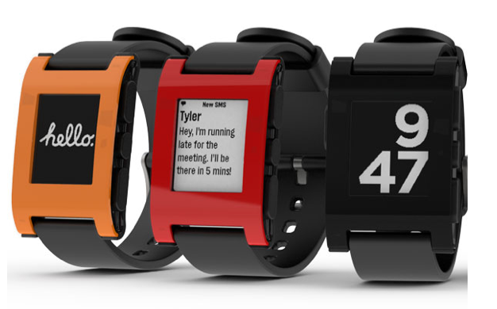
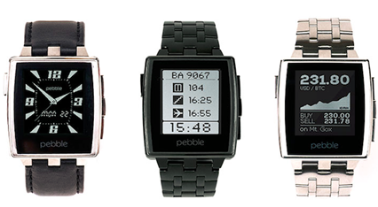
Pebble
Calls management
Music control
Notifications
Navigation
Reader
Fitness
Alarms
Messenger
…
Development:
Pebble apps – classical C
PebbleKit native libraries for Android and iOS.
PebbleKit JS to leverage your phone's resources (Internet, GPS, etc). Cross-platform.

Slide 7
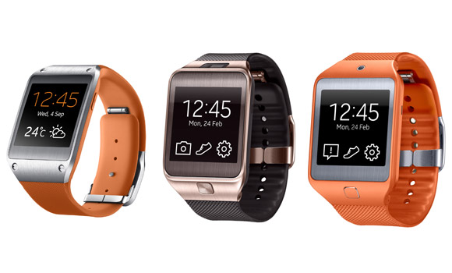
Samsung Gear 2
Seamless Communication
Instant Notification
Everyday Captures
Personalized Fitness Manager
Enjoy Music On The Go
Development:
Host-side Application – Android SDK Wearable-side Widget - Tizen SDK

Slide 8
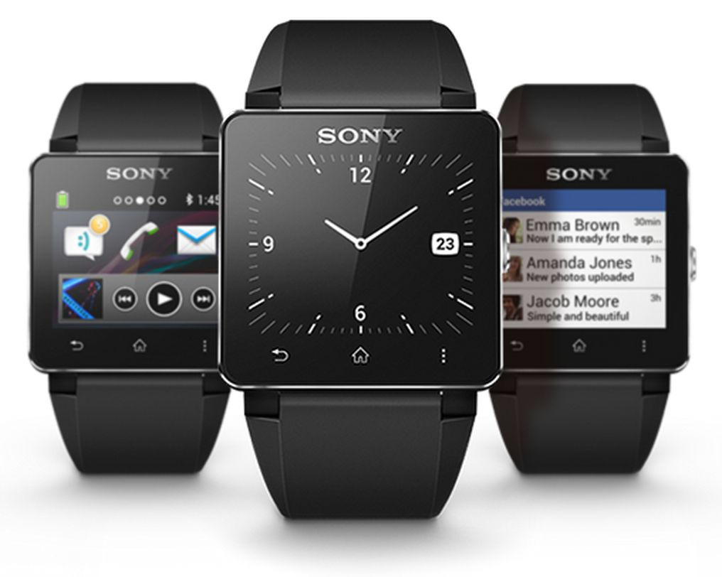
Sony Smartwatch 2
NFC
Calendar
Slideshow
Email
Missed call notification
Calendar reminder
…
Development:
Android SDK - Sony Add-on SDK

Slide 9
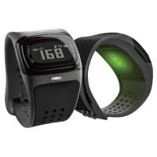
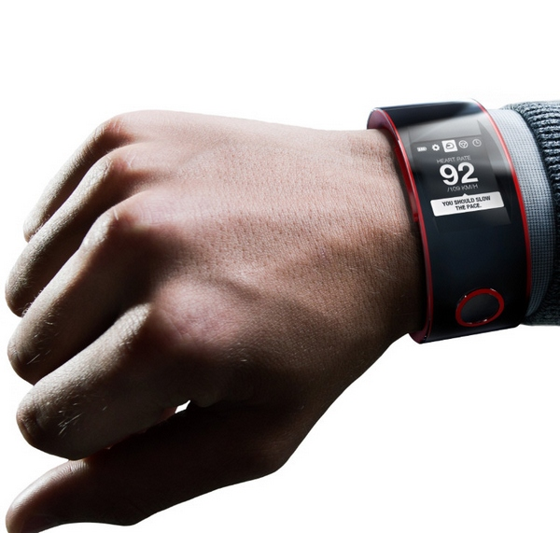
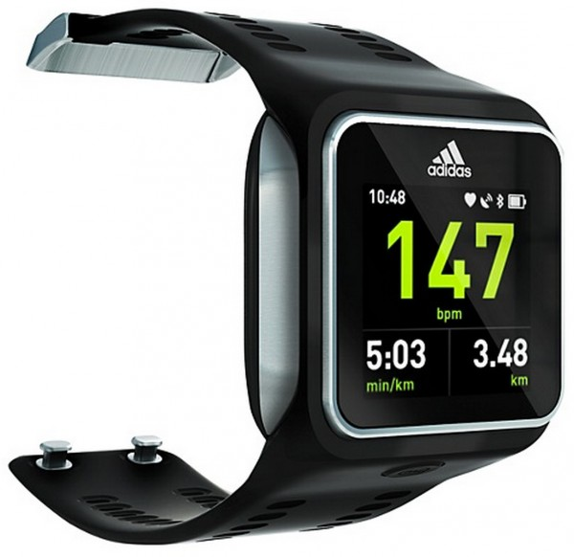
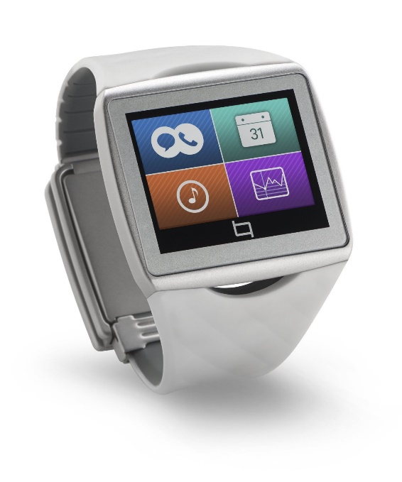
Other
Mio ALPHA Indigo
Nissan Nismo
Adidas MiCoach Smart Run
Qualcomm Toq

Slide 10
Activity trackers

Slide 11
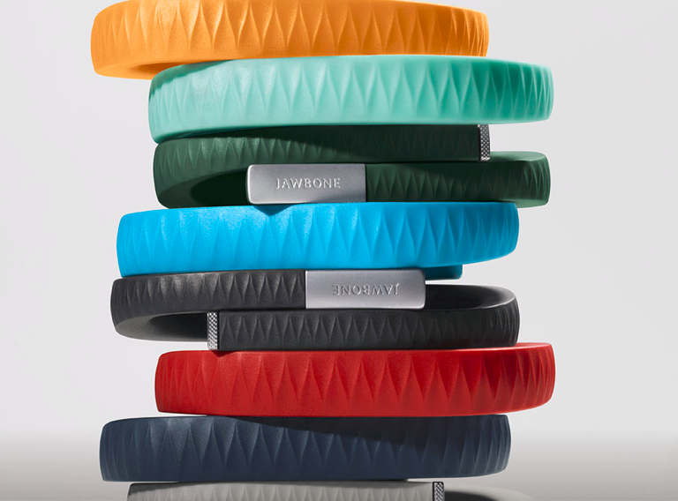
Jawbone Up
Track calories burned, intensity and more for any type of workout.
Food & Drink tracking
UP vibrates to wake you at the
optimal moment in your sleep
cycle so you feel refreshed.
Set a reminder to move when you've been inactive for too long.
Log your moods and discover connections that affect how you feel.

Slide 12
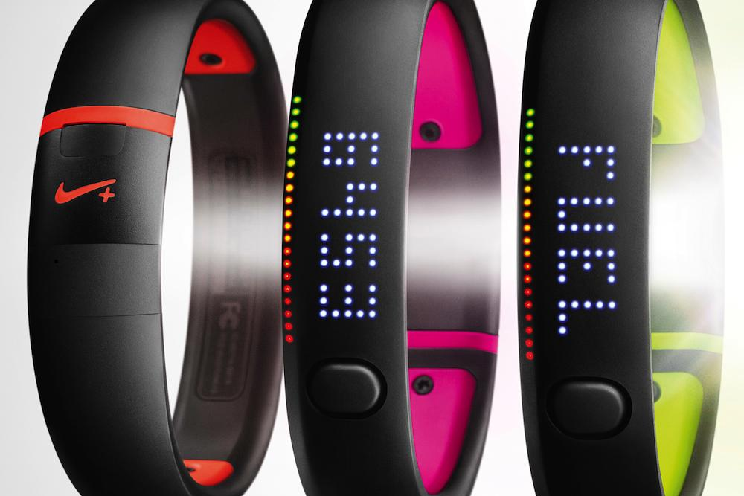
Nike+ FuelBand SE
Gamification inside
Measures all kinds of activities —from your morning workout to your big night out.
Tracks how much, how often, and how intensely you move.
Always connected
More fun with friends and challenges
App lets you see your daily activity breakdown, set goals, and view your progress by week, month, or year. It also automatically sends all your information to your Nike+ profile online.

Slide 13
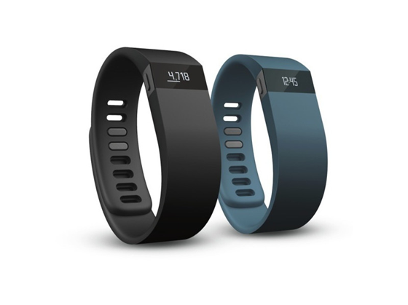
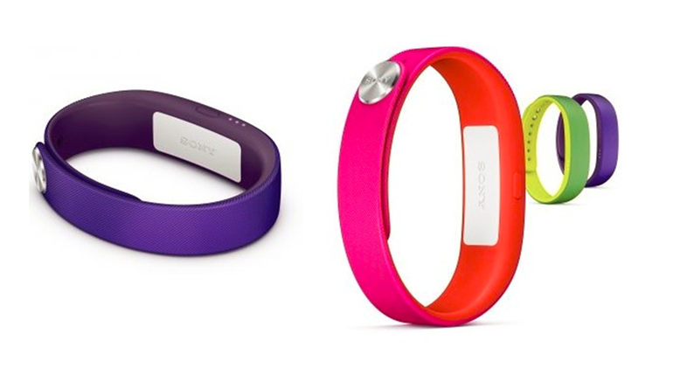
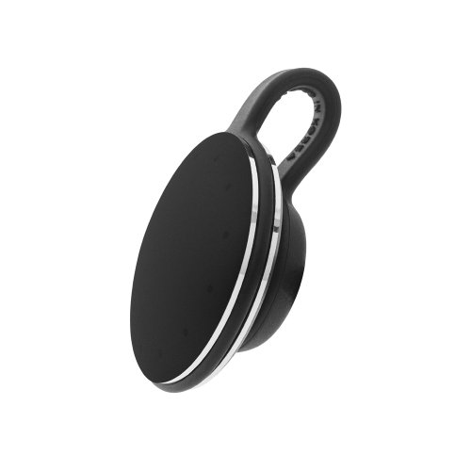
Other
Fitbit Force
Sony SmartBand
Misfit Shine

Slide 14
AR Glasses

Slide 15
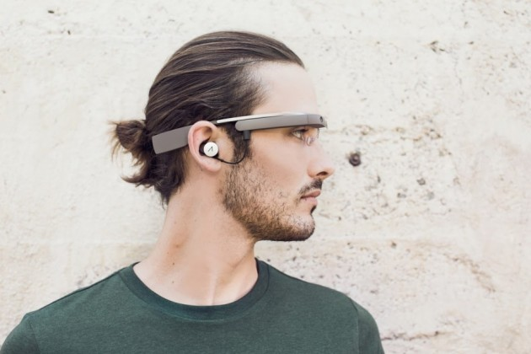
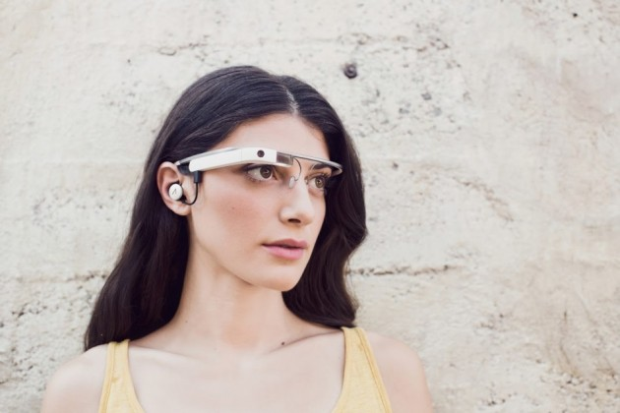
Enhanced Google Glass
Mono-earbud provides much better sound quality compared to the bone conduction system in the first generation
2GB of RAM
12 new apps today including Shazam and Live Stream
Update will also work for people who wear prescription glasses
Development:
The Glass Development Kit (GDK) is an add-on to the Android SDK
Google Mirror API allows you to build web-based services that interact with Google Glass

Slide 16
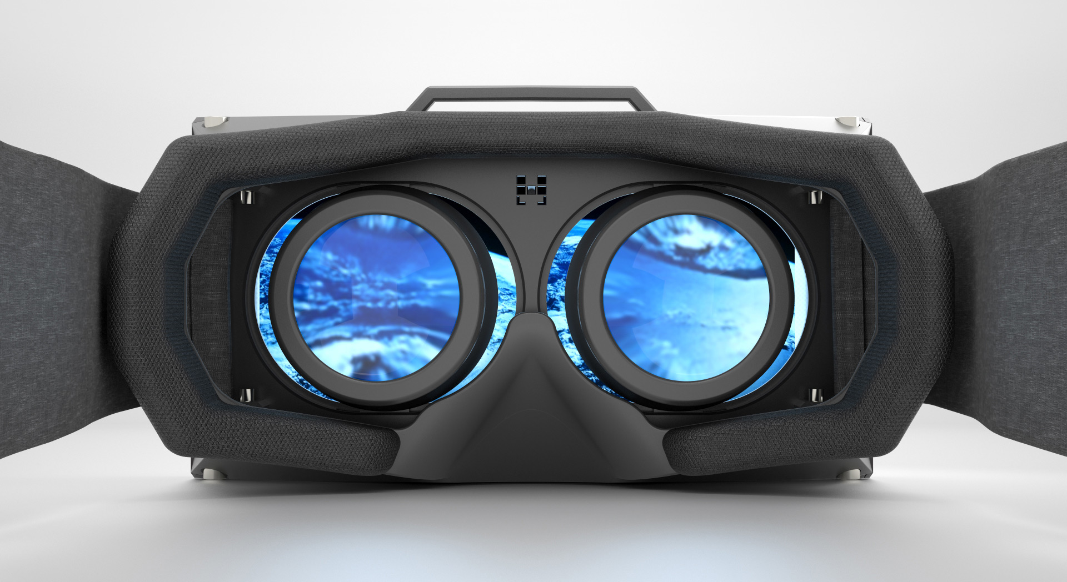
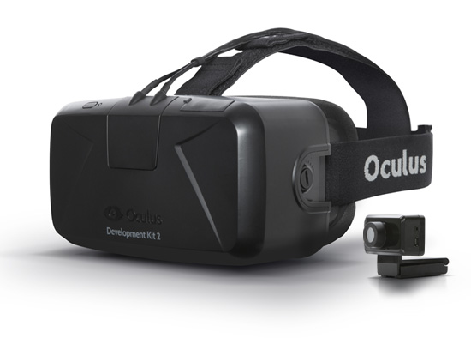
Oculus Rift
Virtual-reality head-mounted display that will work with your computer or mobile device.
Created to deliver world-class gaming experience.
Development:
Oculus Rift Development Kit 2 (DK2) assists developers with integrating the Oculus Rift with their games.

Slide 17

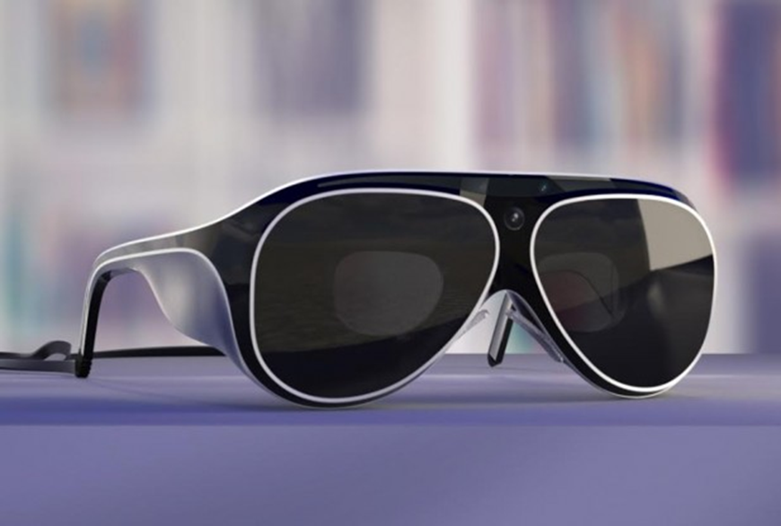
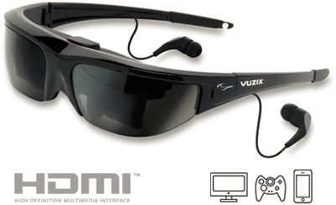
Other
Vuzix

Slide 18

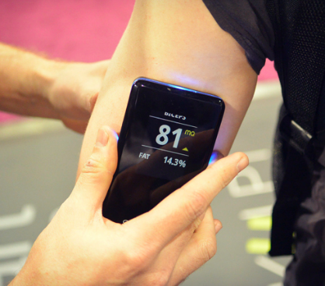
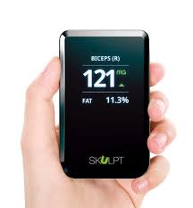
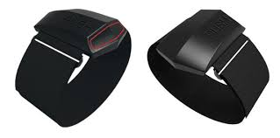
Push
Skulpt

Slide 19

MOTOROLA PATENTS SKIN TATTOO

Slide 20
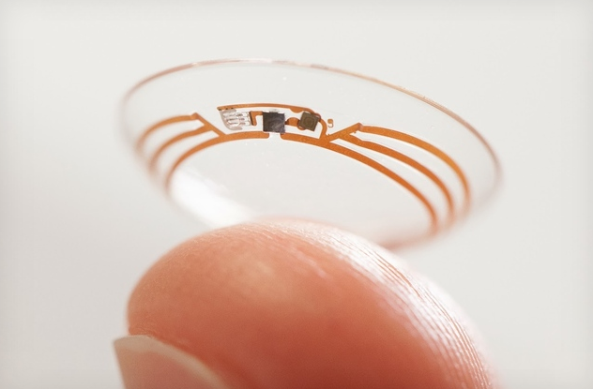
Google’s smart contact lens

Slide 21
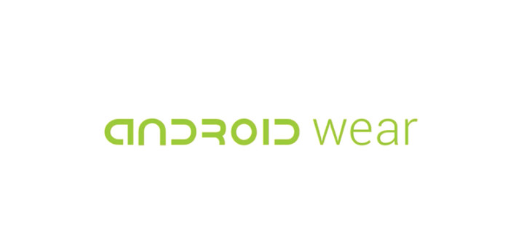

Slide 22
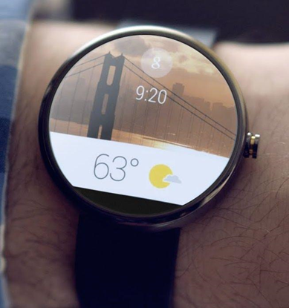
Announced to the public on March 18, 2014, as a modified version of the Android operating system.
Continues the push by Google into the emerging wearable ecosystem.
Serves as a extension of key smartphone capabilities, in a ubiquitous and convenient form-factor.
Google states that Android wear is the following:
Small, powerful devices, worn on the body. Useful information when you need it most. Intelligent answers to spoken questions. Tools to help reach fitness goals. Your key to a multiscreen world.

Slide 23


Slide 24
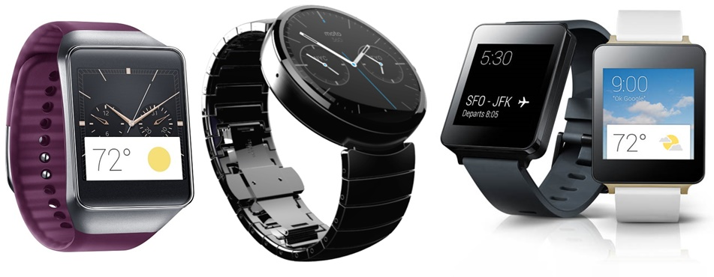
The First Wave
Samsung Gear Live
roughly $199
Motorola 360
Launches in July for roughly $250
LG G Watch
Launches in July

Slide 25
Planned or Potential Uses
Receive/Respond to messages.
Google Now integration
Sleep/Activity Tracking
Control “Internet of Things”
Scannable Ticketing
Multimedia Control
Phone Locating
Augment Google Glass and other Wearables

Slide 26
SDK Comparison
Pebble
C on Watch App
Watch Faces and Watch Apps (watch apps interface with Java app on Android, Objective-C on iPhone)
Accelerometer, LED, Vibration Motor, Battery Interfaces
UI Framework (Windows, BMP, raw Graphics, Menus, etc)
Event services
Logging on Watch
Data storage on Watch
Customizable Phone to Watch message structures
Reuses GCC arm compiler for Watch, existing Mobile IDE
Android Wear
No Watch App, it appears to be an Android app that runs on the Phone.
Simple card based notifications (a la Google Glassware)
Cards are stackable
Voice Input
Reuses existing Android development environments (ADT and Android Studio)

Slide 27
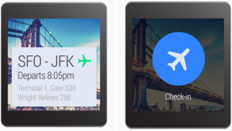
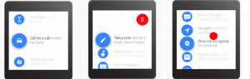
UI Overview
Context Stream:
Shows vertical list of cards.
Each card shows potentially useful information.
One card is displayed on the screen at a time.
Additional visual information can be provided by background images.
If a card is not in use, it can be removed by swapping from left-to-right.
The Cue Card
The cue card is opened by voice input such as, “Ok Google”.
It can also be started by tapping on the “g” icon on the home screen.
It allows users to speak to their device.
Swiping up on the cue card shows a list of actions.

Slide 28
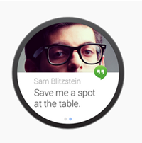
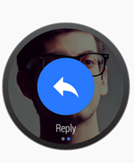
Notifications
Notifications are a core component of Android Wear.
They should reflect the urgency of a notification with priority.
Time-sensitive notifications carry high priority.
Actions
Appear to the right of your notification.
A maximum of three actions are allowed.
These are optional.
An action consists of an icon and a caption.
Captions should be kept short.

Slide 29
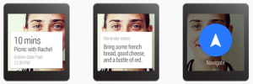
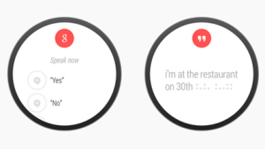
Pages
Use pages to provide additional content and information instead of packing information in primary notification.
Pages appear immediately to the right of the main notification card.
It could be a next train departure card, a card showing the weather forecast, scheduled matches etc.
Voice Replies
Provides a hands-free method of dictating a short message.
Used by messaging applications and suggested to be used to cover a range of simple, neutral replies in the choices you provide.
Five suggested replies can be provided.

Slide 30

Future Plans
Google is planning to launch new APIs for Android wear which will help developers create more customized apps. It may consist of these features:
Building Custom UI. Creating custom card layouts and running activities on wearable’s directly.
Sending Data. Enabling sending data and actions between the wearable and phones with data replication APIs and Remote Procedure Call (RPC).
Control Sensors. The ability to gather sensor data and displaying it in real-time on Android wearables.
Upcoming development also includes:
Launching Android Wear SDK.
Android’s partnership with different vendors to launch devices powered by wearable.

Slide 31
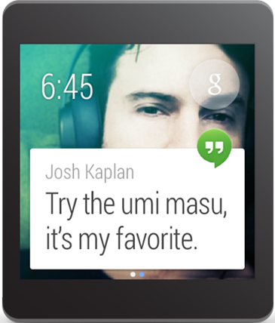
Creating Notifications
Intent viewIntent = new Intent(this,
ViewEventActivity.class);
viewIntent.putExtra(EXTRA_EVENT_ID, eventId);
PendingIntent viewPendingIntent =
PendingIntent.getActivity(this, 0, viewIntent, 0);
NotificationCompat.Builder notificationBuilder =
new NotificationCompat.Builder(this)
...
.setContentIntent(viewPendingIntent);
// Build the notification and issue it notificationManager.notify(notificationId,
notificationBuilder.build());

Slide 32
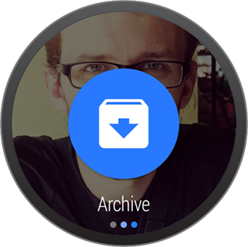
Add Action Buttons
// Build an intent for an action to view a map
Intent mapIntent = new Intent(Intent.ACTION_VIEW);
Uri geoUri = Uri.parse("geo:0,0?q=" + Uri.encode(location));
mapIntent.setData(geoUri);
PendingIntent mapPendingIntent =
PendingIntent.getActivity(this, 0, mapIntent, 0);
NotificationCompat.Builder notificationBuilder =
new NotificationCompat.Builder(this)
...
.addAction(R.drawable.ic_map,
getString(R.string.map), mapPendingIntent);

Slide 33
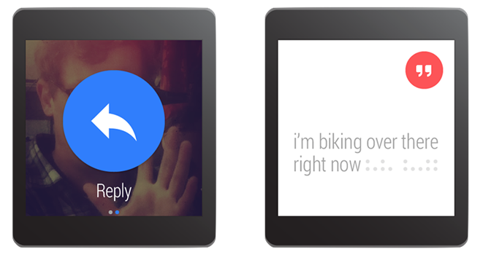
Receiving Voice Input
// Key for the string that's delivered in the action's intent
private static final String EXTRA_VOICE_REPLY = "extra_voice_reply";
String replyLabel = getResources().getString(R.string.reply_label);
RemoteInput remoteInput = new
RemoteInput.Builder(EXTRA_VOICE_REPLY)
.setLabel(replyLabel)
.build();

Slide 34
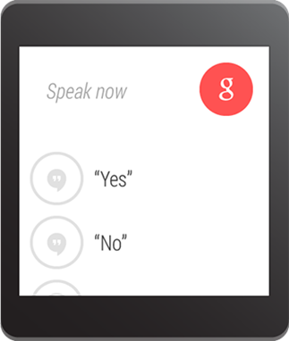
Pre-defined text responses
res/values/strings.xml
<?xml version="1.0" encoding="utf-8"?>
<resources>
<string-array name="reply_choices">
<item>Yes</item>
<item>No</item>
<item>Maybe</item>
</string-array>
</resources>
String replyLabel = getResources().getString(R.string.reply_label);
String[] replyChoices =
getResources().getStringArray(R.array.reply_choices);
RemoteInput remoteInput = new RemoteInput.Builder(EXTRA_VOICE_REPLY)
.setLabel(replyLabel)
.setChoices(replyChoices)
.build();

Slide 35
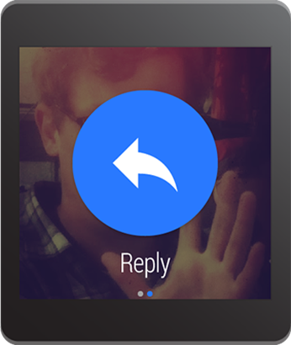
Create Voice Input for Action
// Create intent for reply action
Intent replyIntent = new Intent(this, ReplyActivity.class);
PendingIntent replyPendingIntent =
PendingIntent.getActivity(this, 0, replyIntent, 0);
// Build the notification
NotificationCompat.Builder replyNotificationBuilder =
new NotificationCompat.Builder(this)
…
.setContentText("I love key lime pie!")
.setContentIntent(replyPendingIntent);
// Create the remote action input
RemoteInput remoteInput = new
RemoteInput.Builder(EXTRA_VOICE_REPLY)
.setLabel(replyLabel)
.build();
// Create wearable notification and add remote input
Notification replyNotification = new
WearableNotifications.Builder(replyNotificationBuilder)
.addRemoteInputForContentIntent(remoteInput)
.build();

Slide 36
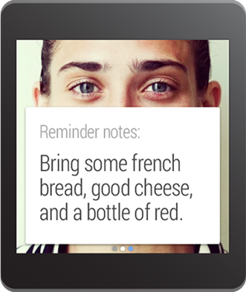
Adding Pages to Notification
// Create builder for the main notification
NotificationCompat.Builder notificationBuilder =
new NotificationCompat.Builder(this)
...
.setContentIntent(viewPendingIntent);
// Create a big text style for the second page
BigTextStyle secondPageStyle = new
NotificationCompat.BigTextStyle();
secondPageStyle.setBigContentTitle("Page 2")
.bigText("A lot of text...");
// Create second page notification
Notification secondPageNotification =
new NotificationCompat.Builder(this)
.setStyle(secondPageStyle)
.build();
// Create main notification and add the second page
Notification twoPageNotification =
new WearableNotifications.Builder(notificationBuilder)
.addPage(secondPageNotification)
.build();

Slide 37


Slide 38

Other

